Slide 1
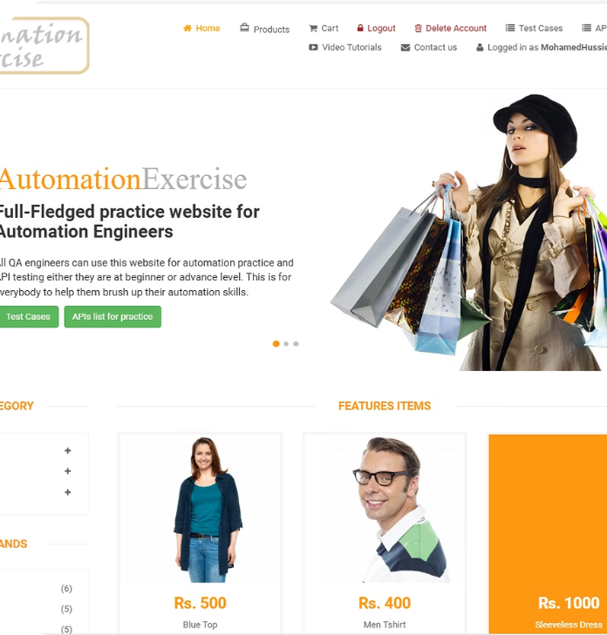
Automation Exercise E-commerce Website
Overview of testing methodologies for Automation Exercise e-commerce site.

Slide 2
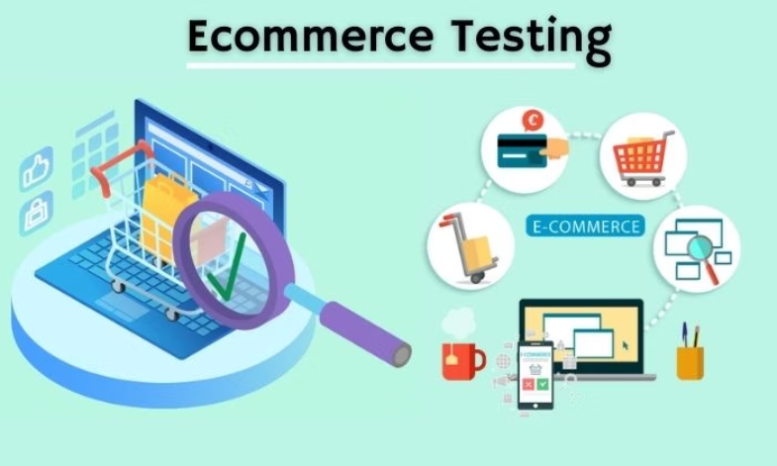
Testing Scope
User Management
Product Management
Shopping Cart & Checkout
Contact and Support
Automation and API Testing

Slide 3
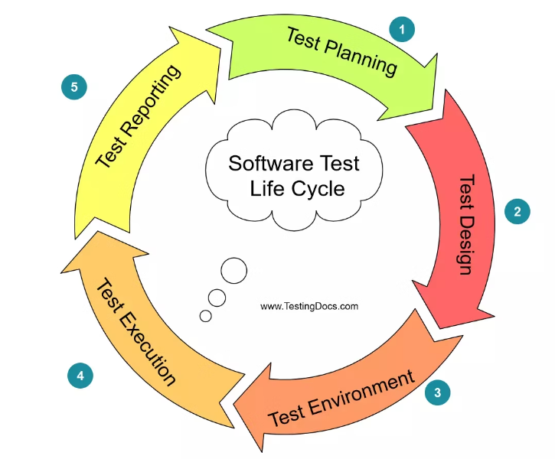
Testing Life Cycle

Slide 4
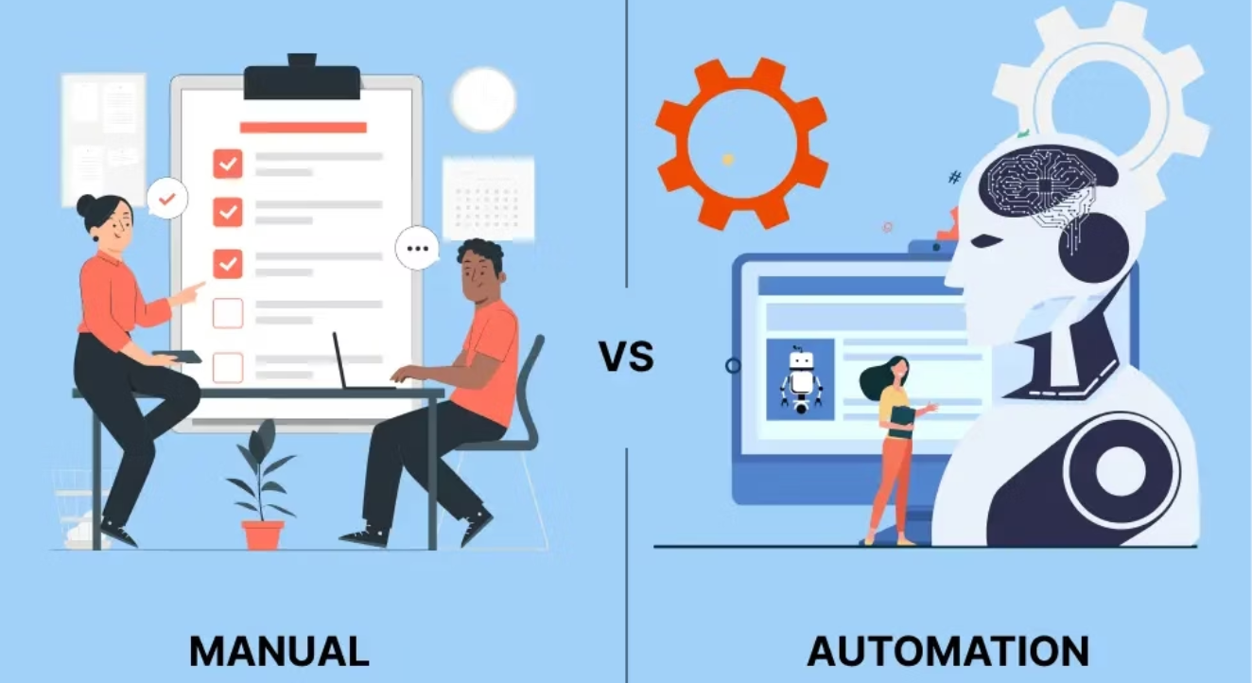
HOW?

Slide 5

Manual Testing
It’s Focusing on what can’t be measured with the automated tests
Design and execute test cases manually
Identify UI/UX and functional bugs
Ensure business requirements compliance

Slide 6
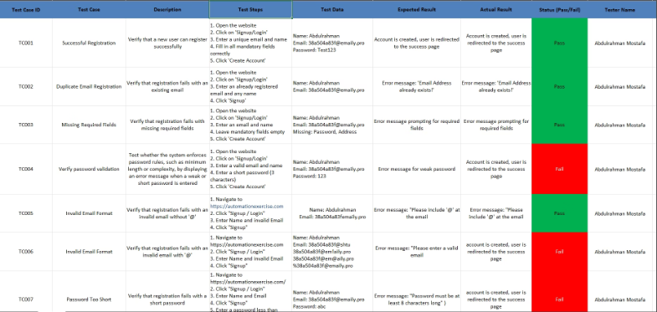
Test Cases
A total of 102 test cases were created to validate the core features of the system.
These cover various user scenarios and ensure the website meets functional requirements with high reliability.

Slide 7
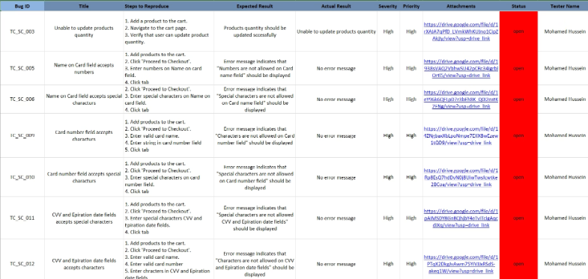
Bug Tracking
Throughout the testing process, 23 bugs were reported.
These findings reflect real user interactions and helped improve the overall system quality through effective debugging and retesting.

Slide 8
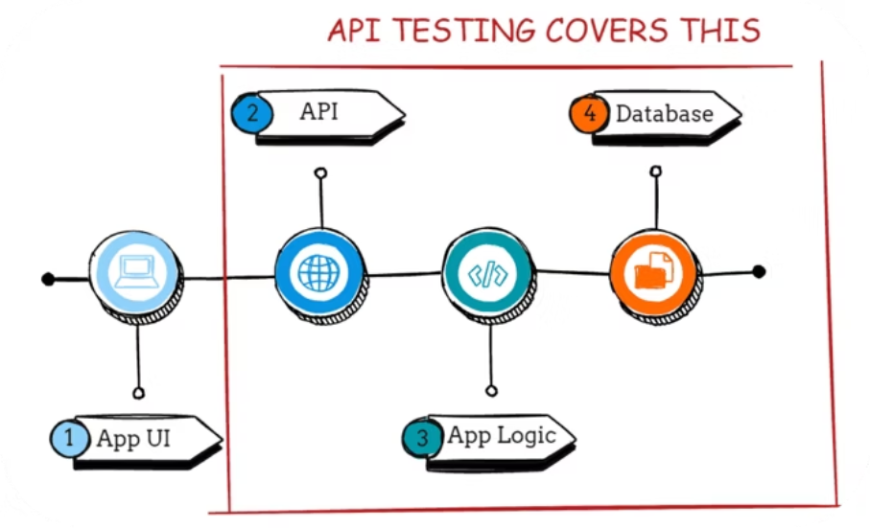
API Testing
Requirement Analysis
Planning The Test Cases
Writing Test Cases

Slide 9
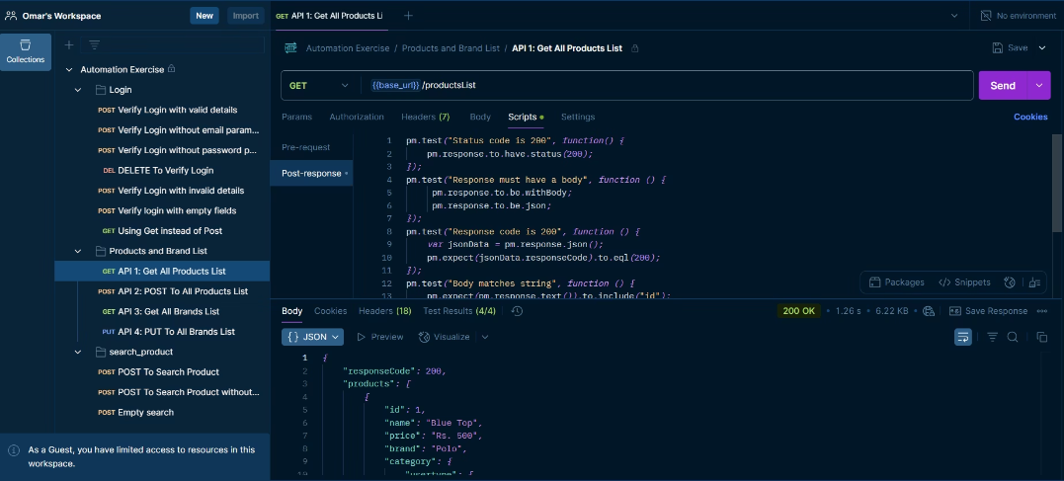
API Testing
Test GET, POST, PUT, DELETE requests for backend reliability.

Slide 10

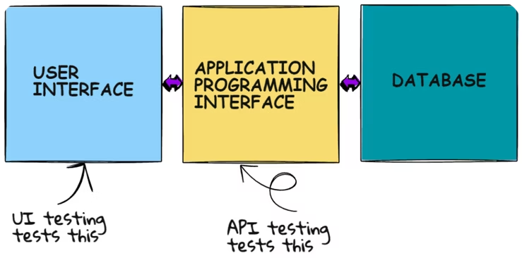
Automation Testing
It’s about writing a code to test some code

Slide 11

Automation Testing Details
Tools & Framework
Selenium WebDriver, Java, TestNG framework
Design Pattern
Page Object Model (POM) for maintainability
Reporting
Allure Report for test results visualization
Execution
Automated scripts for regression and functional tests

Slide 12
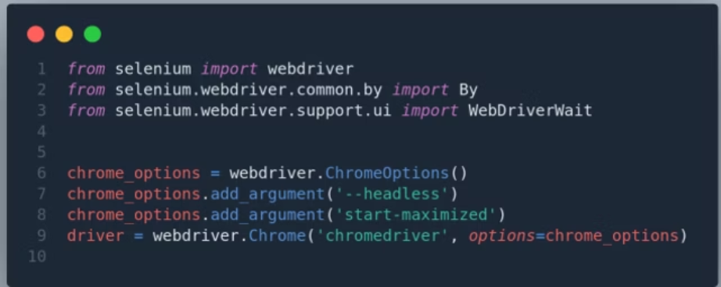

Automated UI Tests
Using web driver to simulate all the user interactions

Slide 13
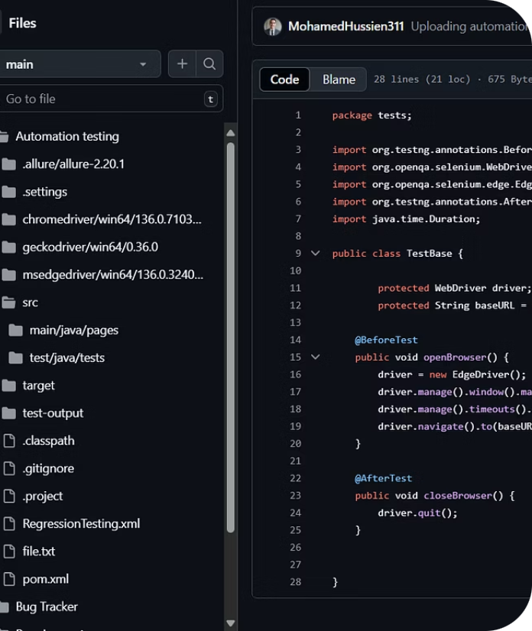
Project Structure
src/main/java/pages
Page Object Model
src/test/java/tests
Tests
reports
Allure reports
pom.xml
Maven dependencies
README.md
Project documentation
RegressionTesting.xml
Regression test cases

Slide 14
Prerequisites for Testing
Java JDK 8+
Maven Installed
Selenium WebDriver
TestNG Framework
Postman for API Testing
Allure for Test Reports

Slide 15





Setup Instructions
Clone Repository
git clone https://github.com/MohamedHussien311/DEPI_Grad_Project_AutomationExerciseWebsite.git
Navigate Directory
cd DEPI_Grad_Project_AutomationExerciseWebsite
Install Dependencies
Run mvn clean install
Run Tests
Manual: follow test cases
API: use Postman collection
Automation: mvn test command

Slide 16

Test Reports
Allure Report Generation
View Reports
Run "allure generate" to generate reports
Run "allure serve" to open generated report in browser

Slide 17

Contribution Guidelines
Follow project structure for new test cases
Use proper naming and documentation
Run all tests before committing changes

Slide 18
Languages Used
88%
12%
Java
JavaScript

Slide 19


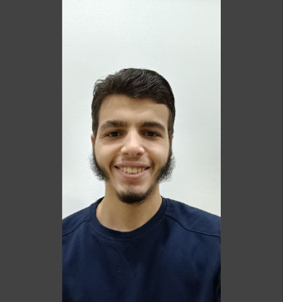
Project Contributors
Omar Saleh
Mohamed Hussein
omarsaleh.os04@gmail.com
mohamedelaraby7798@gmail.com

Slide 20
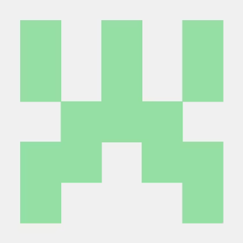
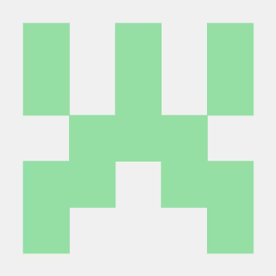
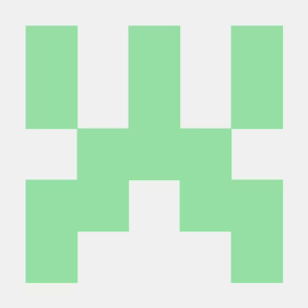
Project Contributors
Khaled Ahmed
Abdallah Mohamed
Abdulrahman Mostafa
xsky0sama@gmail.com
abdullah439875@feng.bu.edu.eg
abdomostafa511@gmail

Slide 21

Thank You!

